Slide 1
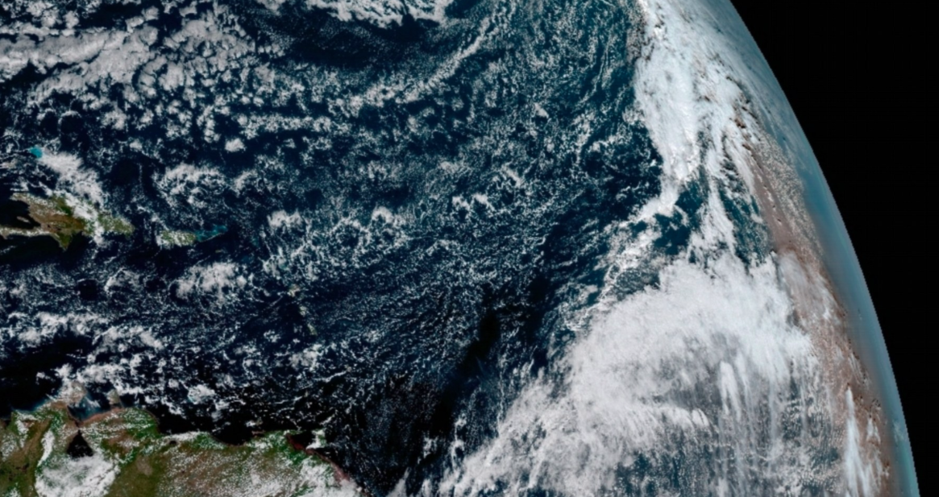
Data 225 - Group Project
U.S. Climatological data analysis
in Google Cloud Platform
Group 4
Presented by:
Anshul Yadav
Sakshi Jain
Shreya Sree Matta
Vatsalya Pooja Chintapalli
Veena Ramesh Beknal

Slide 2
Index
Problem statement and context
Data overview
Google Cloud Platform overview
VPC connection
Cloud architecture of solution
Scheduling using Airflow
Data warehousing with BigQuery
Visualization with Looker
Statistics and ML use cases
Conclusion and Recommendations
Possible future enhancements

Slide 3
Problem statement and context
The role of weather data is critical in numerous applications, including predicting weather patterns, studying climate change, and understanding local weather conditions
We are focused on the U.S. Local Climatological Data obtained at a station level from the National Oceanic and Atmospheric Administration (NOAA)
Through comprehensive analysis of historical data and with real-time data, we would like to analyse the questions listed below:
What is the trend of weather patterns over time across the US?
Are there zones/clusters of regions where climate change is more prominent than others?
What areas in California can utilities companies such as PG&E focus their efforts on to address the surge in demand ahead of time in a data-driven manner? (to reduce stress on the power grid in peak power consumption periods like winter and snow)

Slide 4
Data overview
NOAA (National Oceanic and Atmospheric Administration) is the primary data source for weather information and we’re working with 3 key datasets
Historical weather data from NOAA’s FTP server (link) - this contains data for weather stations from 180 countries but we’re filtering for USA only
We have considered data from 2020 to 2023 and this data altogether amounts to ~1.5 GB
Real time weather data from NOAA’s web services API (link)
Weather station mapping for California stations (FIPS:06) from NOAA’s web services API
From these, we’re working with 3 weather metrics Temperature (TMIN, TMAX, TAVG), Precipitation (PRCP) and Snowfall (SNOW) captured for each day for each weather station

Slide 5
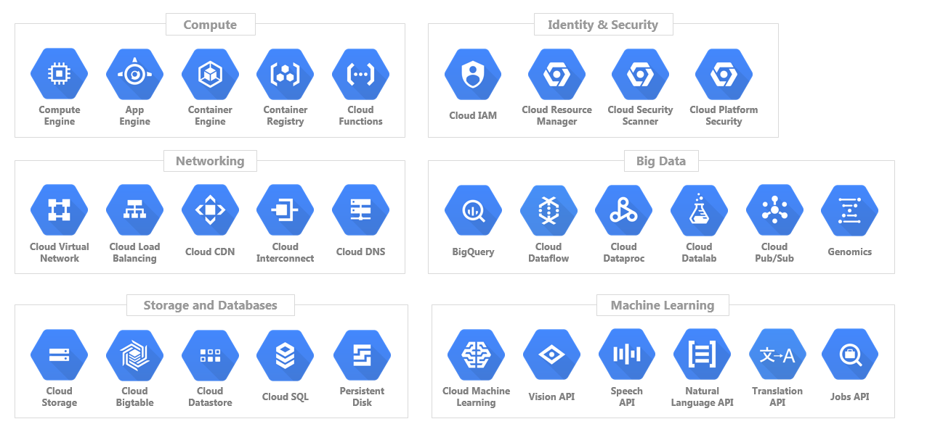
Google Cloud platform contains multiple tools for working with data or applications of any scale and is relatively easy to use

Slide 6
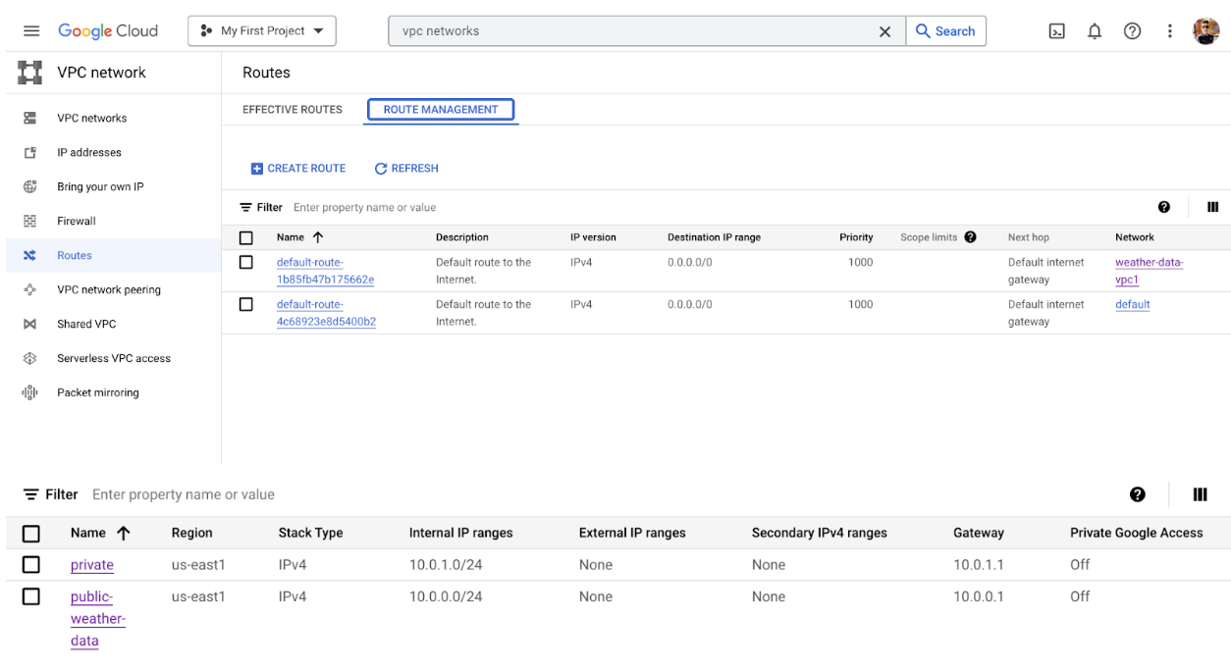
VPC was setup in GCP with 2 subnets and customized routes for optimal data transit
Network Configuration Details:
Subnets: private (10.1.0.1/24), public-weather-data (10.0.0.0/24)
Routing: Customized routes for directed traffic management and optimized data transit.
Private Google Access: Ensured private connections to Google services without using external IP addresses, maintaining data privacy and integrity.

Slide 7
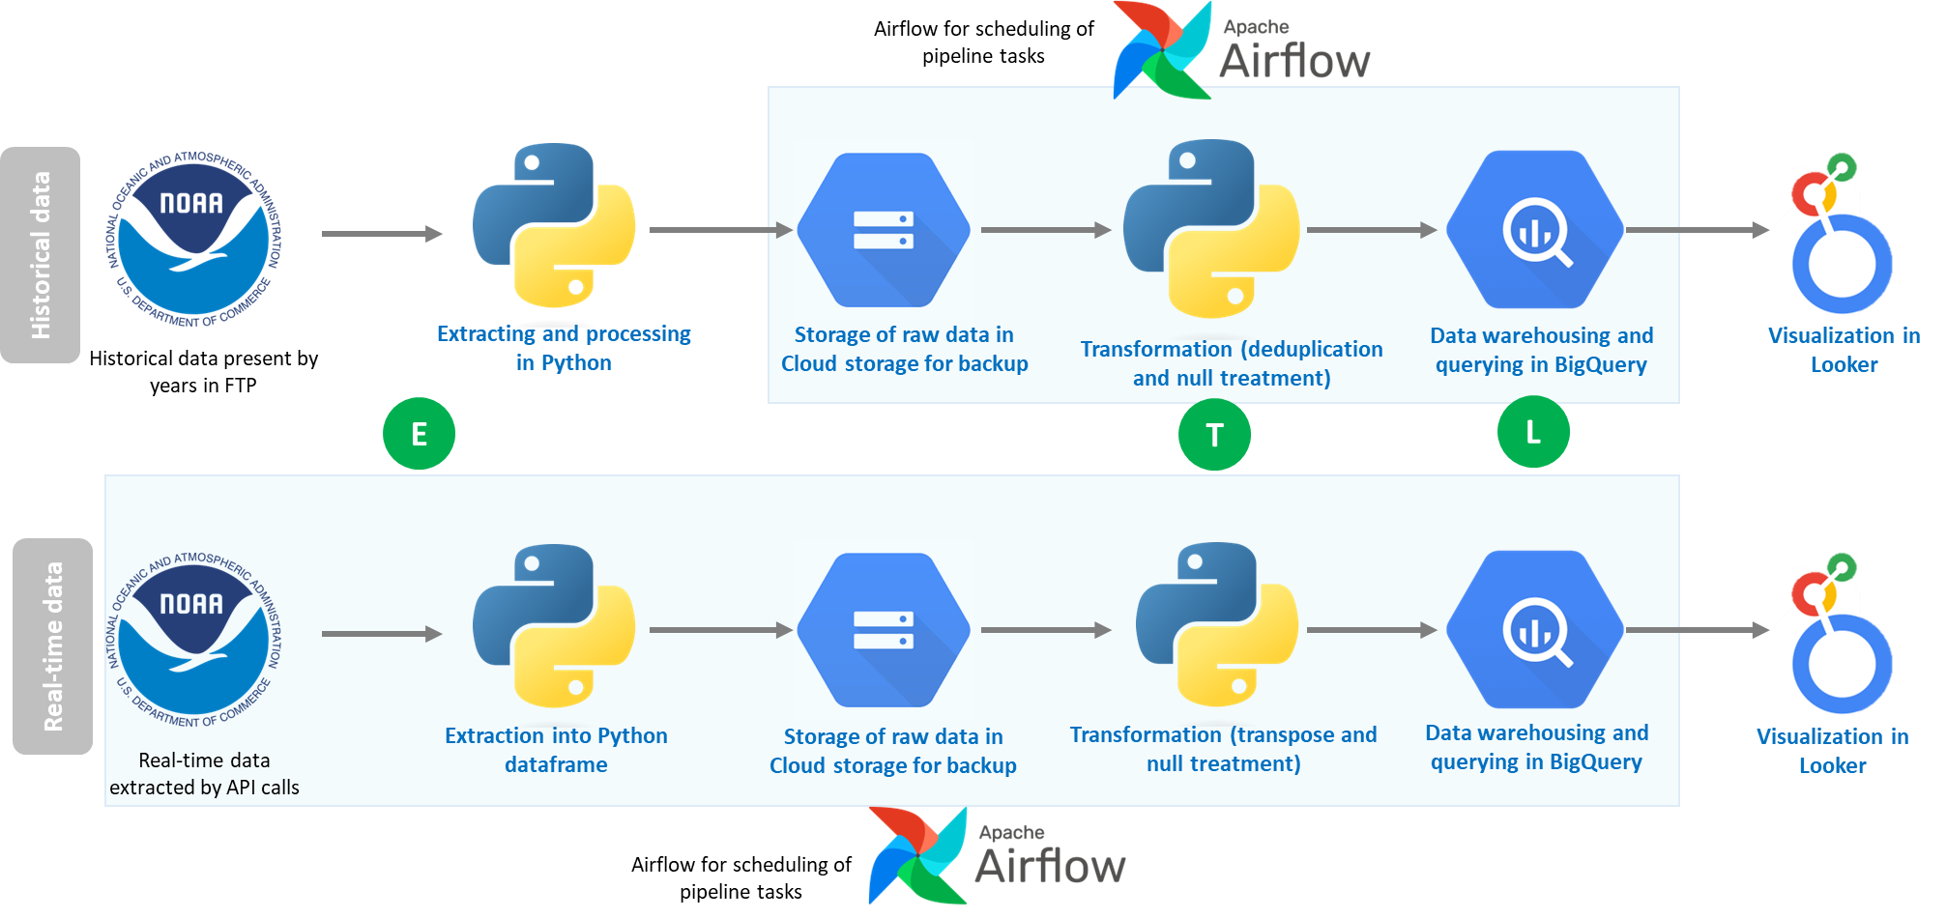



We’re using GCP to orchestrate the flow for both historical and real-time data (separately) using a combination of tools
Extract
Transform
Load

Slide 8
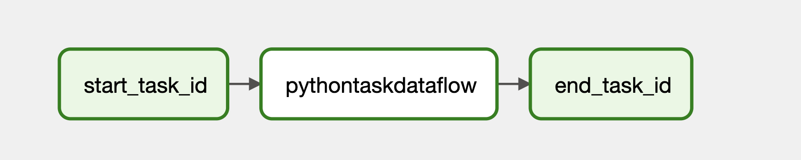
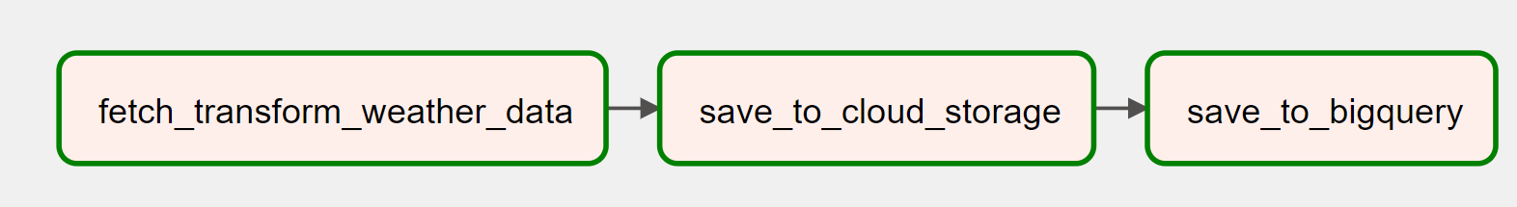
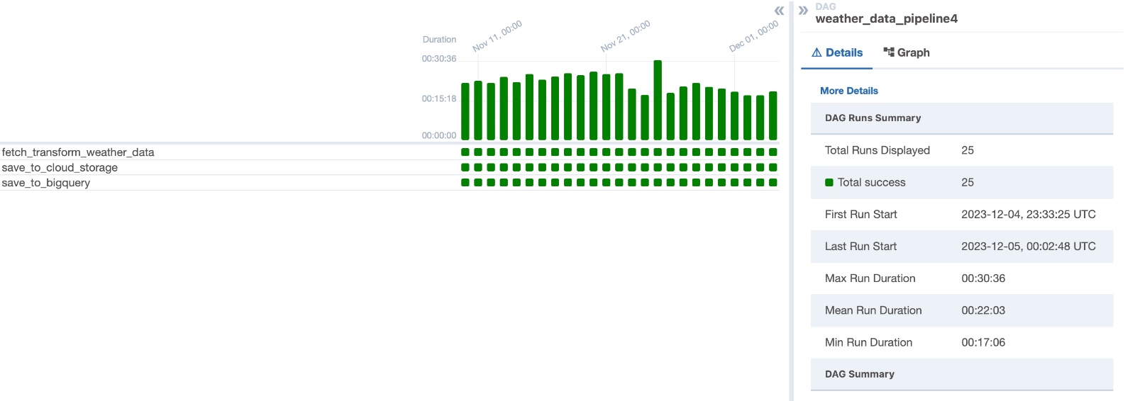
2 Airflow DAGs were created in Composer - 1 for ETL of historical data, the other for real-time data
Historical data ETL DAG tasks:
Extractingdata from Cloud Storage bucket
Transformation to remove duplicates and convert NA in PRCP to 0
Write to BigQuery master table for historical data
Real-time data ETL DAG tasks:
Extracting data from API call
Transformation to filter for required metrics and transpose
Write csv to cloud storage bucket
Write to BigQuery master table fo real-time data

Slide 9

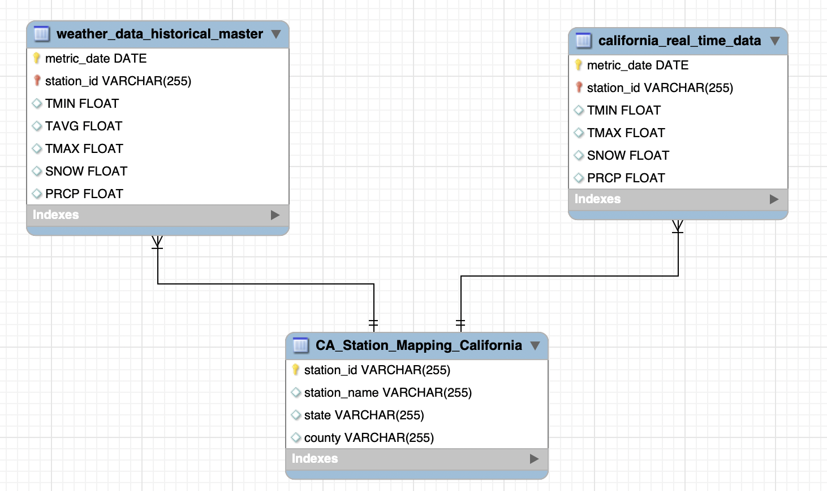
Our warehousing solution was BigQuery due to its scalability and ease of use for storing, staging and querying structured data

Slide 10
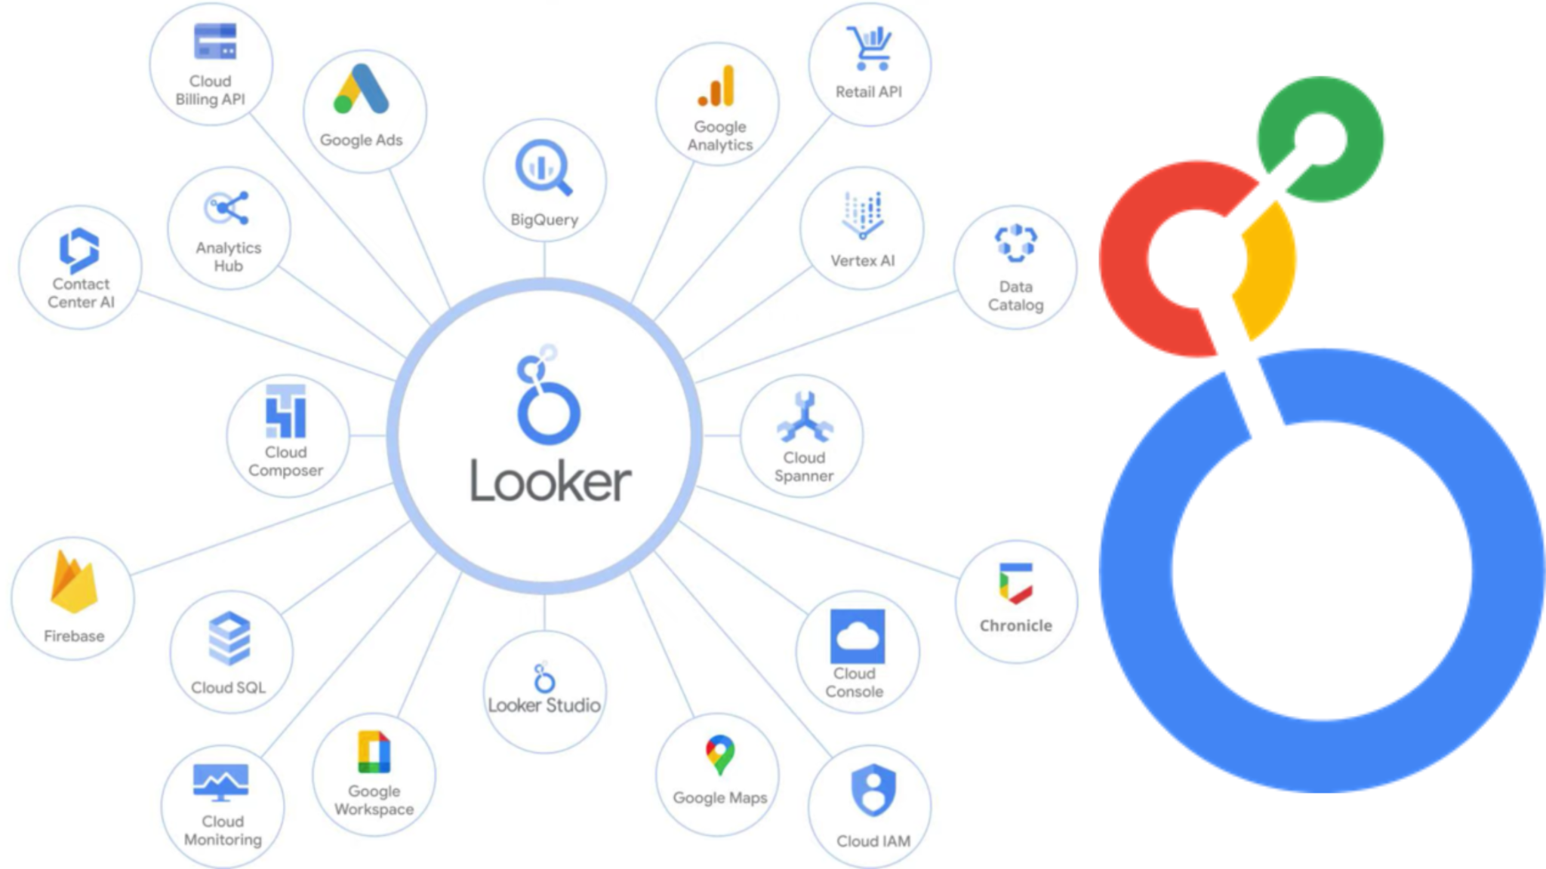
Our BI/visualization solution was Looker since BigQuery datasets or custom queries can directly be loaded into it for visualization

Slide 11
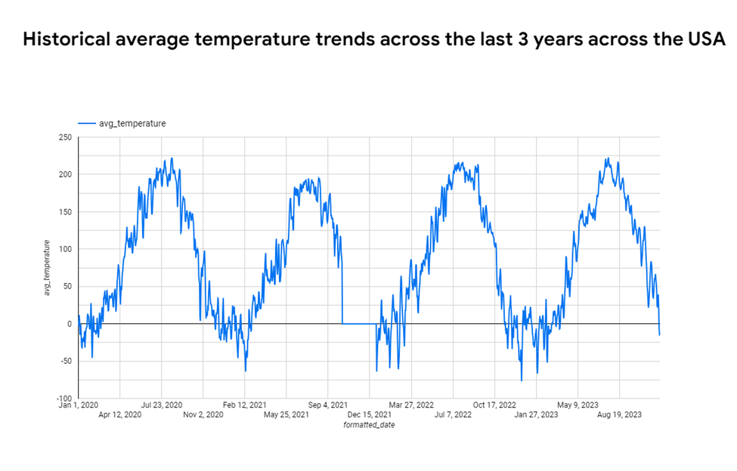
Looker use case 1: Overall trend of average temperature over time
Use case 1:
Studying the overall temperature over the last few years shows us that weather follows a cyclical pattern and a slight increase is noticed year on year

Slide 12
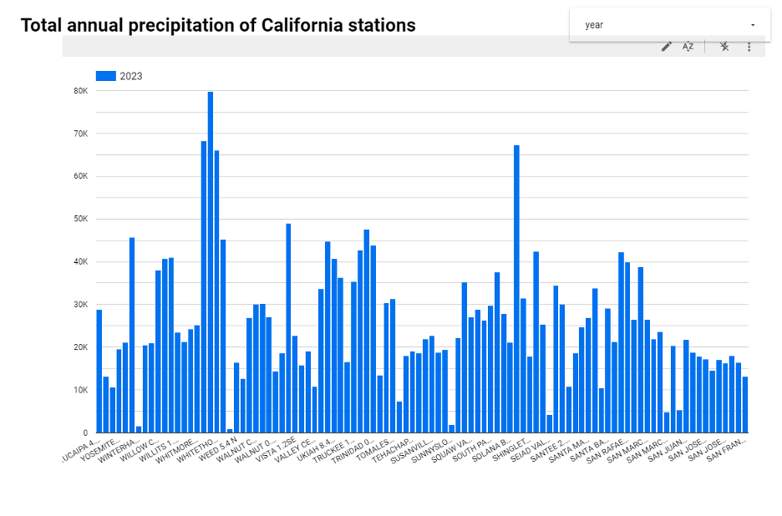
Looker use case 2: Annual precipitation of California weather stations
Use case 2:
Total annual precipitation for each weather station, while the X-axis shows the various weather stations.The bars show how much precipitation was measured at each station; some had considerably larger totals than others, reflecting variations in the distribution of rainfall in California

Slide 13
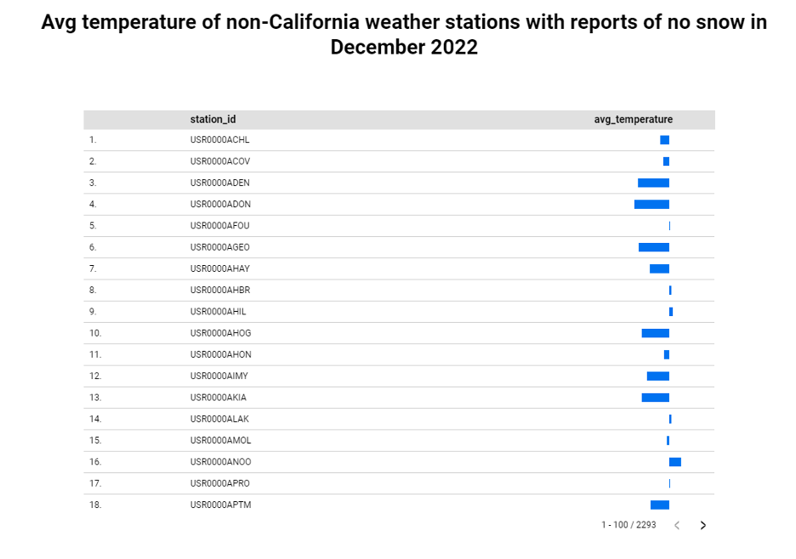
Looker use case 3: Avg temperature of non-California stations that didn’t record snow in Dec 2022
Use case 3:
The average temperature recorded at each station is represented by the length of each bar, which shows a comparison of temperatures across different areas that did not report any snowfall during the month

Slide 14
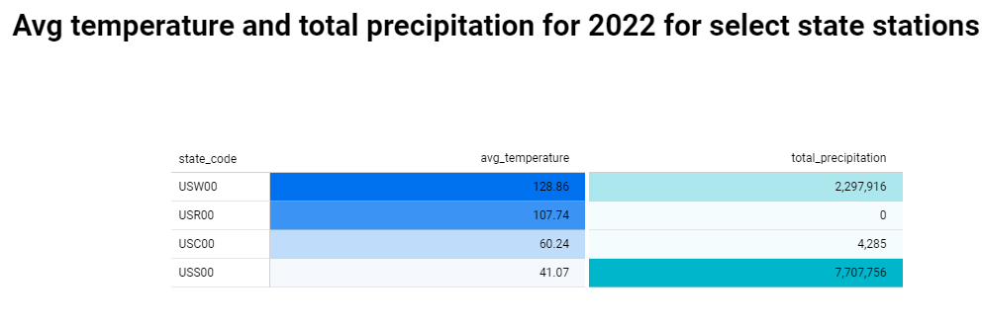
Looker use case 4: Avg temperature and precipitation for specific stations in 2022
Use case 4:
The first set of bars represents the average temperature in kelvin scale for the year 2022
The second set depicts the total amount of precipitation in an undefined unit for the same period.
The length of the bars varies, representing the variations in temperature and precipitation between the states

Slide 15
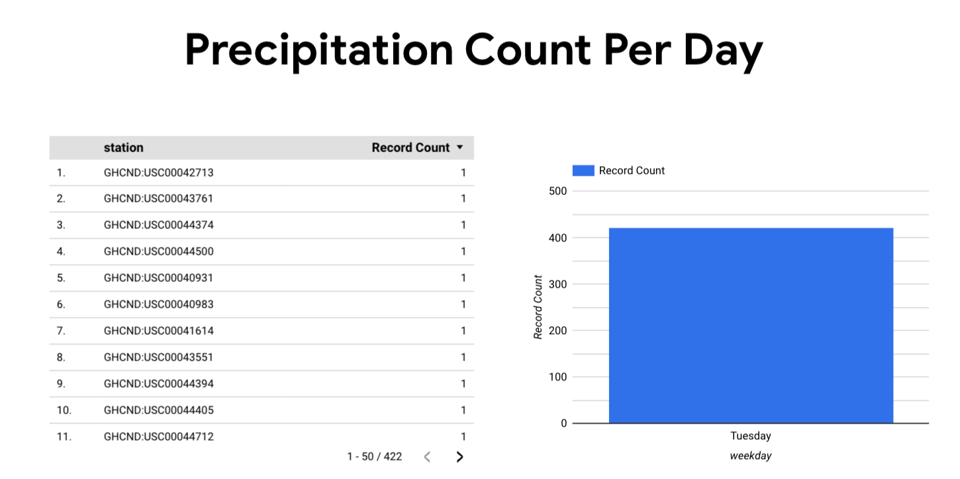
Looker use case 5: Real time precipitation each day
Use case 3:
Shows the precipitation record count per day at each station.Performed on real time data.

Slide 16
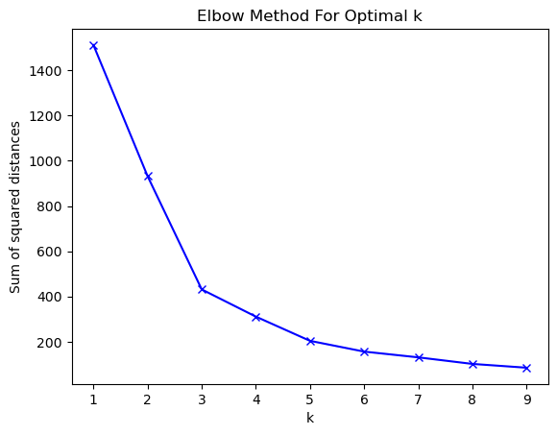
We used kmeans clustering to identify groups of stations that had similar extreme weather conditions
California is one of the most geographically diverse states in the US
Hence, for such a unique region, it is essential for utility companies like PG&E (California’s largest utilities provider) to understand weather patterns in order to be prepared for seamless power supply even in extreme conditions
In order to do this, we propose a novel approach of using k-means clustering to identify clusters or groups of stations that have similar precipitation and snowfall conditions
We considered 756 weather stations in the state of California for which we had good coverage of precipitation (total precipitation for year 2022) and snowfall (average yearly snowfall) data
In Elbow curve method, we plot the different values of k against the sum of squared distances (SSD) between each point from the respective cluster centroids
Optimal value of k is chosen based on the “elbow” point or the point beyond which the rate of decrease of SSD is not as gradual
We can notice that the elbow point in the above graph is 5

Slide 17
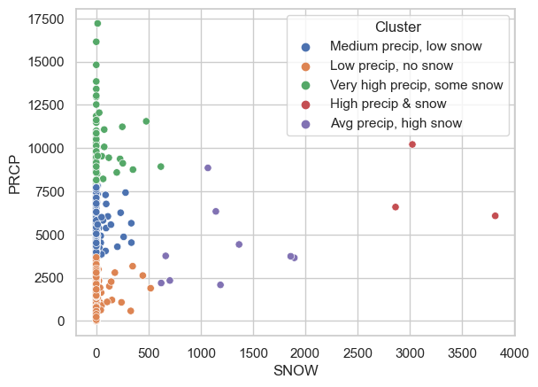
We identified 5 clusters that had similar characteristics of snow and precipitation across the chosen California stations
Based on analyzing the clusters, we can observe that there each station can show 1 among 5 characteristics shown below:
Medium precipitation with low snow - habitable regions
Low precipitation with no snow - dry habitable regions
Very high precipitation with some snow - wet regions
High precipitation and snow - extreme regions
Average precipitation and high snow - snowy regions

Slide 18
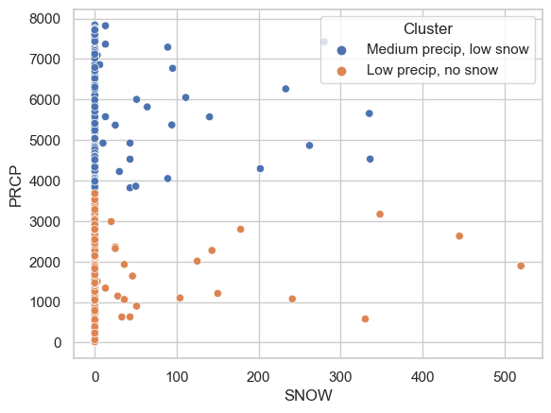
There were 3 clusters that had extreme values that skew the visualization of the clusters
Visualizing the results, we can observe that clusters d & e are outliers - there are 73 extreme regions (~10% of the stations considered for the clustering exercise) that PG&E must prioritize
After removing the clusters with extreme outliers we can observe that scatter plot is bit more spread
Our recommendation to PG&E is to focus on building infrastructure capacity to cater to identified areas with extreme snow and precipitation conditions

Slide 19
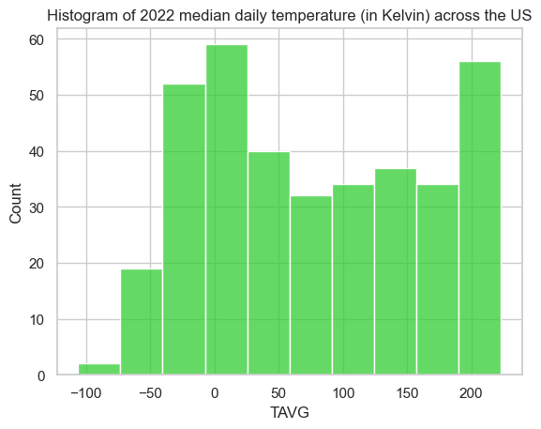
Shapiro Wilk test to understand if median daily temperature across 2022 follows a normal distribution
In the Shapiro-Wilk test, null hypothesis = Sample is from the normal distributions.(p-value>0.05)
Hence, if we obtain a p-value > 0.05, we accept the null hypothesis and can conclude that the data is normally distributed
To understand the median daily temperature for the year 2022 we performed Shapiro Wilk test
Through visual inspection of the histogram, we see a somewhat bimodal distribution of data and doesn't look like a bell curve.
The p-value <0.05 implying that we reject the null hypothesis and can conclude that the data is NOT normally distributed

Slide 20
t-test to understand the median TAVG (avg temperature) across all stations for each day of year for 2021 and 2022
Our hypothesis was that there would be a significant difference between these 2 years’ temperatures.
We ran a t-test with our null hypothesis being “There is no significant difference between the temperatures of 2021 and 2022”
Hence our alternative hypothesis becomes “There is a significant difference between the temperatures of 2021 and 2022”
The outcome was that the p-value for the independent t-test was lower than the critical value i.e. 0.05, indicating that we have sufficient evidence to reject the null hypothesis and conclude that there is a significant difference between 2021 and 2022 temperatures

Slide 21
Conclusion and Recommendations
Based on our exploration of both AWS and GCP, we can conclude that that GCP is the easier platform to set up and use; while AWS had multiple options and services, there is a learning curve to get started on it
We experimented with Cloud Dataflow for transformation and loading into BigQuery, it is a useful service for large scale ETL jobs where there’s a continuous flow of data
Looker is a good BI tool for basic visualization and reporting and integrates well within GCP but lacks the depth of functionality that Tableau or PowerBI offers
Based on our analysis of weather data, we noticed that there was a significant difference between overall temperatures between 2021 and 2022, indicating that temperatures are increasing due to global warming
Weather data follows a cyclical pattern and the trend of weather repeats over time, this helps in predictability of weather patterns over time
There are 73 stations with extreme weather conditions (snow and precipitation) that PG&E must prioritize for ensuring seamless power supply during extreme weather events

Slide 22
Possible future enhancements
Getting historical data for the last 20-30 years will give us richer insights about historical weather trends and patterns
Real-time data can directly be extracted from APIs and ingested using GCP’s Cloud Pub/Sub service, the equivalent in AWS is Kinesis
Advanced ML can be done in GCP through BigQuery ML and CloudML in GCP, equivalent in AWS is AWS Lambda and Sagemaker
Cloud Dataproc can also be used in GCP for comprehensive data processing of large dataset - the equivalent in AWS is Glue
A fully managed pipeline can be built in GCP using a combination of Pub/Sub, Cloud Storage, Cloud Dataflow/Dataprep, Dataproc, Apache Beam and BigQuery although this would also come at a significant cost

Slide 23
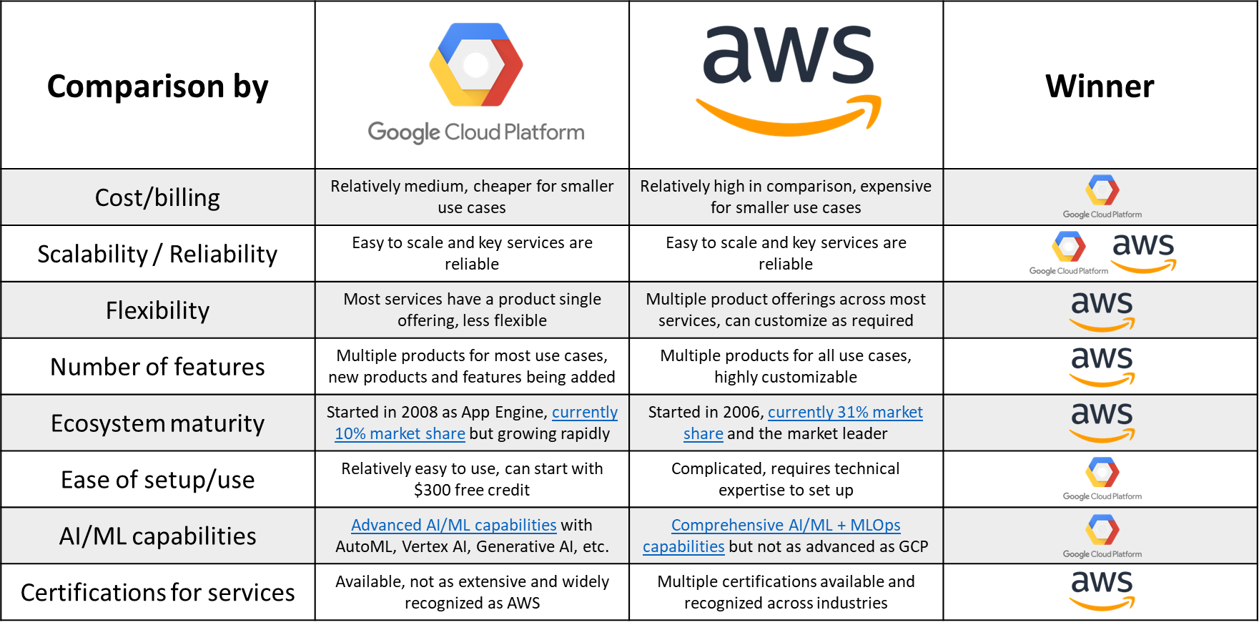
Appendix: Comparison between AWS and GCP

Slide 24


